Slide 1
Test-Driven Development (TDD): An Overview
Terrence Mahnken – Application Engineer II @ HCA

Slide 2
Agenda
Overview (10 min.)
Hands-On Activity (40 – 45 min.)
Summary & Retrospective (5 – 10 min.)

Slide 3
TDD Overview
Test-Driven Development: An Overview

Slide 4
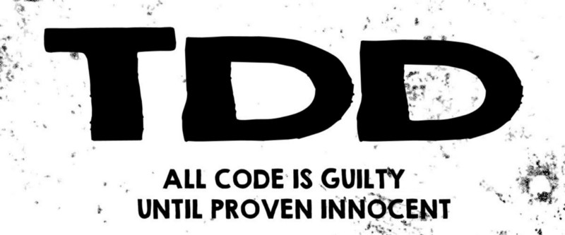
“Test Driven Development: What it is and What it is Not” by Andrea Kouifaris
Notes:
Starts with this mindset …

Slide 5
What is TDD?
Write tests FIRST
Write code AFTER
Red, Green, Refactor
Notes:
Traditionally, development is plan, write, review with little to no testing.
At worse development is done “instinctively”

Slide 6
Red, Green, Refactor
Red
One test that describes the behavior
Must fail
Green
Minimal code to pass
No more, no less
Refactor
Eliminate duplication and unwanted code
Rerun
Notes:
Red:
Make decisions about how the code will be used
Based on what you really need at the moment, NOT what you THINK you need
Common mistake: writing too much (functions, classes, etc.)
Over-engineering = writing something the feature doesn’t require
Green:
Whatever it takes to make the test pass
Allowed to violate best practices and duplicate code
Common mistake: writing too much
Write enough to make the test pass
Refactor:
Change the code while keeping all tests green
MANDATORY
Remove duplicate code

Slide 7
Components of TDD
Process
Tools
Unit Test
Covers a small portion of logic
Deterministic
Independent
Notes:
Process:
Red, Green, Refactor
Upcoming Steps
Tools: (Upcoming)
Unit Test:
Write enough to fail
Test independently
Algorithm or Component
Should never have side-effects
Calls to external APIs
Change the data
Instead, mock the data
Written for a feature request or a bug in PROD
Ideally, written by BA/QA

Slide 8
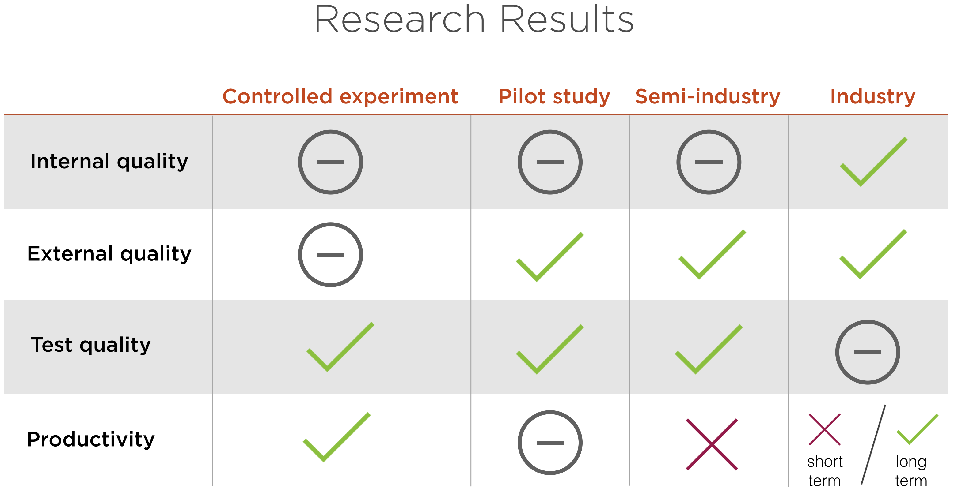
Why use TDD?
More maintainable code
Higher-quality code
(Mostly) bug free
Defense
“Test Driven Development (TDD) Research” by Amy Dredge

Slide 9
Benefits of TDD
Improved test coverage
40%-80% fewer bugs in production*
Documentation and proof
Decreased debugging time/effort
Eliminates fear of merging
*”TDD Changed My Life” by Eric Elliott

Slide 10
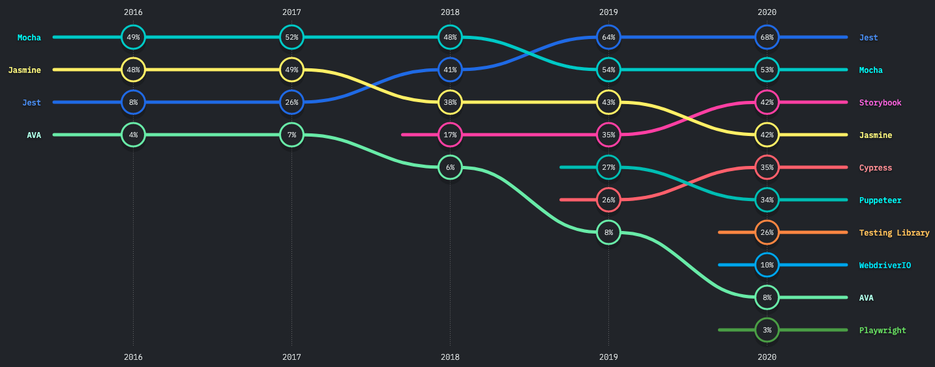
State of JS 2020: Testing - Usage
Enzyme – React Testing Utility

Slide 11
Hands-On Activity
Test-Driven Development: An Overview

Slide 12
Summary & Retrospective
Test-Driven Development: An Overview

Slide 13
Steps of TDD
Write Unit Test Case
Execute Test
Write Code
Execute Test
Refactor Code
Notes:
Write Unit Test Case
Small as possible
Independently tested
Execute Test (1)
Write code for a failing test
Provides focus – ensures the developer does not get carrier away
Write Code
Just enough to pass
Execute Test (2)
Fails? – Rework
Passes – Move to step 5
Refactor Code
Do NOT change functionality
Alter to enhance performance
Remove duplicate/dead code
Simply nested classes/functions
Consolidate conditional expressions
ADDITION – Execute Test (3)

Slide 14
Rules of TDD
Write only enough of a unit test to fail
Write only enough production code to make the failing test pass
Notes:
Paraphase of Robert ”Uncle Bob” Martin’s Rules for TDD - http://cleancoder.com/products

Slide 15
Common Mistakes
Symptom | Fix
Test isn’t telling me anything | Test at a lower level Check for an exception
Test needs too much setup | Possible code refactor
Test is confusing | Refactor to an un-DRY, single, inline test Work in a new file
App doesn’t have enough (or any) test coverage | Assume existing behavior is correct Use code’s current out to build high-level coverage
No idea what I’m doing | Ask for clarification on requirements
Don’t have time | TDD is a safety net Good tests guide good code

Slide 16
Alternatives to TDD
Acceptance Test Driven Development
Test cases are written when user stories are written
Test cases are written by tester; code written by coder
Behavioral Driven Development
Adds a BA
Provides requirements
Provides relevant examples
Tests are in natural language

Slide 17
Sources
“Test Driven Development (TDD) Research” by Amy Dredge
“TDD Change My Life” by Eric Elliott
“5 Steps of Test-Driven Development” by Grant Steinfeld
“How to TDD when TDD is Hard” by Aaron Sumner
“Test Driven Development: What it is and What it is Not” by Andrea Koutifaris
“Software Delivery Using Test Driven Development (TDD)” by Abhinav Kaiser
“Refactoring the Three Laws of TDD” by Javier Trevino Saldana
State of JS 2020

Slide 18
Thanks!
Terrence Mahnken
HCA Application Engineer II
terrence.codes
Test-Driven Development: An Overview

